Slide 1
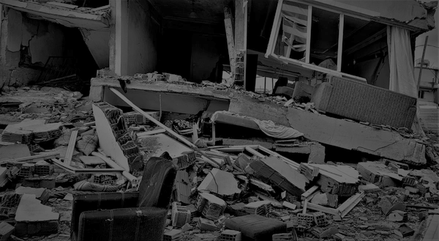
Hierarchical Framework for Disaster Assessment: Fusing Social-Media Signals with Satellite Imagery Analysis
Team Members:
Shreeyash Baranwal
Pratheek Alineni
Shruthika Reddy Sainapuram
Devi Sri Sagurupilli

Slide 2
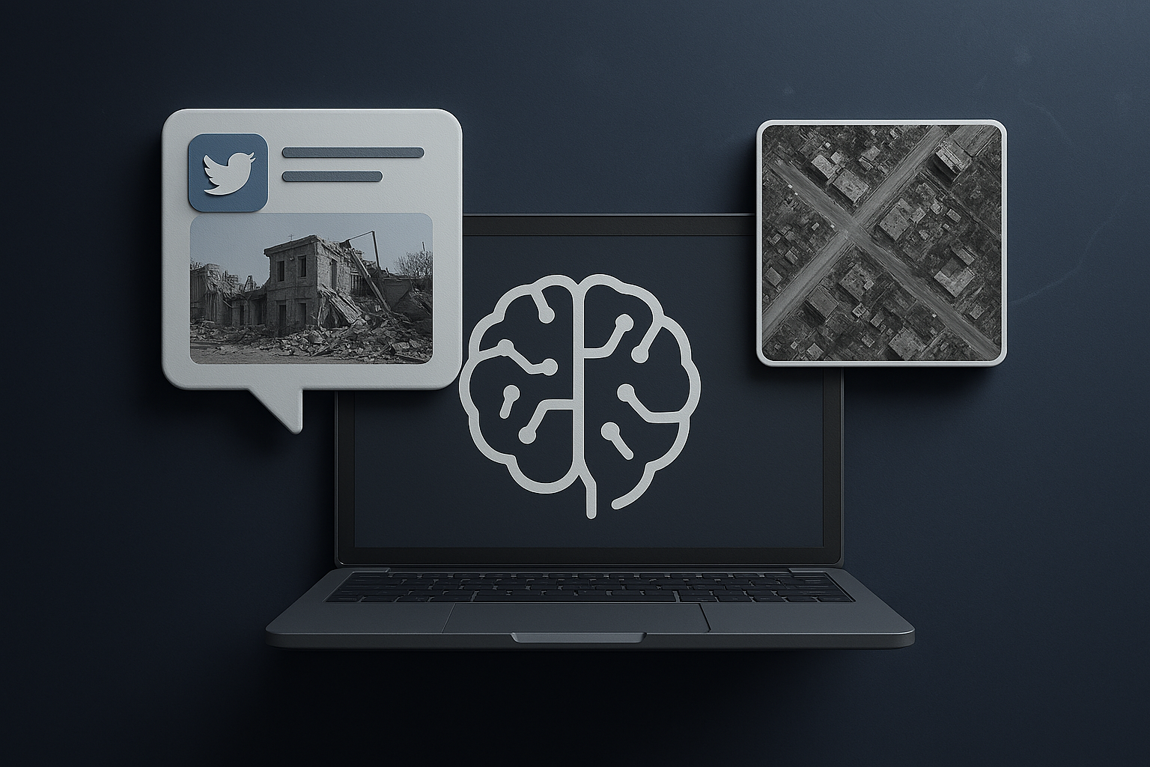
Problem definition & Goal
• Disaster response needs fast and reliable estimates of damage.
• Social media is real-time but noisy and unstructured..
• Satellite imagery is spatially precise but slower to acquire and process.
Goal:
Explore whether combining social-media signals and satellite imagery can support a hierarchical damage-assessment pipeline:
Stage 1: classify crisis tweets and photos.
Stage 2: segment damaged buildings in high-resolution satellite imagery.

Slide 3
Motivation
Why Automated Disaster Assessment?
Disaster response depends on fast situational awareness.
Manual damage assessment is slow, labor-intensive, and risky..
Social media offers real-time, crowdsourced insights.
Satellite imagery provides large-scale, objective structural data.
Multi-modal analysis can capture both urgency (social) and spatial accuracy (satellite).
Key Challenge: Each modality behaves differently- tweets are noisy, social images are inconsistent, and satellite imagery is huge. We examine how a hierarchical two-stage pipeline could work in the real world.

Slide 4

Research Question & Hypothesis
Research Question:
Can multi-modal models of crisis tweets (text + attached photos) and a U-Net model for satellite imagery provide better disaster damage assessment than single-modality baselines?
Hypothesis:
For social media:
Text + image fusion will achieve higher macro-F1 than text-only or image-only models for damage severity.
For satellite imagery:
A U-Net trained on post-event tiles will achieve meaningful IoU/F1 for damaged-vs-not-damaged buildings even without pre-event imagery.

Slide 5
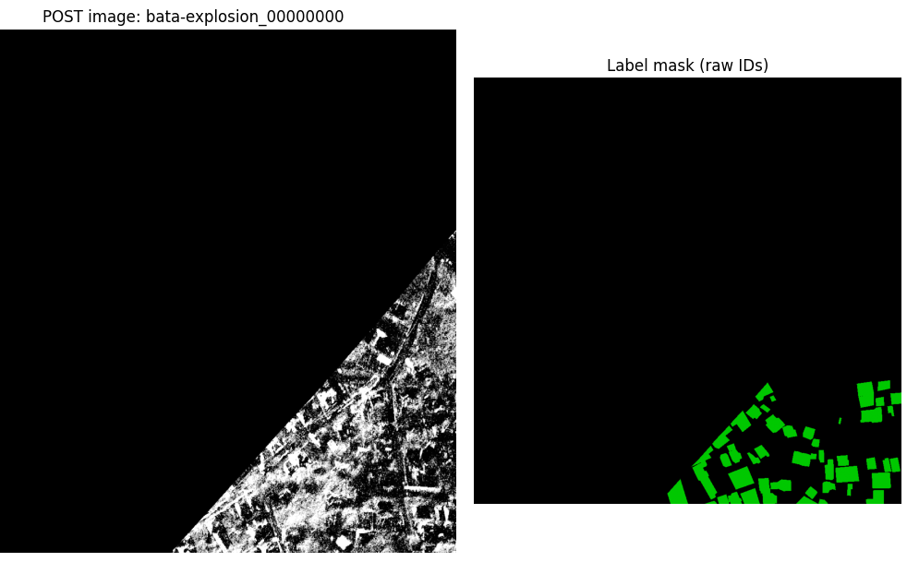
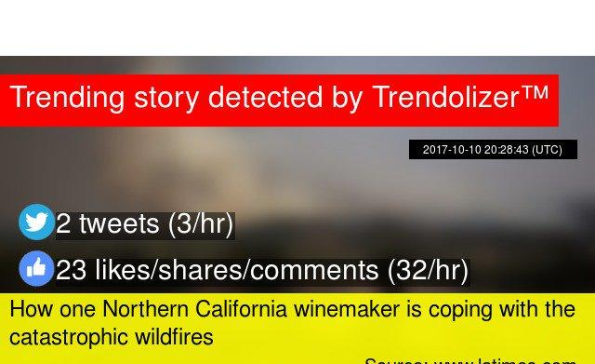
Methodology overview
1. CrisisMMD v2.0 (Social Media)
18k+ tweet–image pairs from real disasters
Labels used:
Task 1: Informative vs. Not Informative
Task 2: Humanitarian category (8-class)
Task 3: Image‐based damage severity (little/none, mild, severe)
Each example has tweet text + an attached image.
2. BRIGHT (Satellite)
4,246 post-event scenes, each with:Pixel-level building-damage masks
Post-disaster satellite image (.tif)
Building-damage mask (.tif)
From these we generate 36,832 tiles of size 256×256 for training

Slide 6
System Pipeline
CrisisMMD:
Robust TSV Loader
Train BERTweet/Twitter-RoBERTa (text)
Train ConvNeXt-Tiny (images)
Fuse outputs
BRIGHT:
Tile satellite rasters
Train U-Net to generate pixel masks

Slide 7

CrisisMMD Preprocessing
Text Processing
Cleaned tweets (URL/user masking, hashtag normalization)
Removed noise (emojis/encoding issues)
Tokenized using BERTweet
Label Preparation
Standardized all labels for: Informative, Humanitarian, Damage
Synchronized “not_informative” ↔ “not_humanitarian”
Image Processing
Loaded tweet images & resized to 224×224
Basic augmentations + ImageNet normalization
Dataset Assembly
Fixed inconsistent TSVs & image paths
Removed missing/corrupted samples
Created clean train/dev/test splits

Slide 8
CrisisMMD – Modeling Approach
Text Model
BERTweet-base
Fine-tuned for:
Informative vs Not-Informative
8-class Humanitarian Categories
3-class Damage Severity (text-only baseline)
Class balancing (weights / focal loss where needed)
Image Model
ConvNeXt-Tiny classifier
Trained on tweet images for 3-class damage severity
Fusion Strategy
Late fusion at inference
Combined probabilities: p_fused = α * p_image + (1−α) * p_text
Tuned α on validation → best performance at α ≈ 0.6
Tweet Text
Tweet Image
BERTweet-base
ConvNeXt-Tiny
Text class probabilities
Image class probabilities
Late Fusion

Slide 9
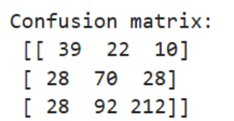
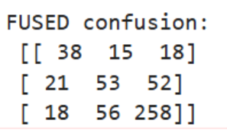
CrisisMMD - Results
Model | Accuracy | Macro-F1
Informativeness (BERTweet) | 0.84 | 0.79
Humanitarian (CardiffNLP RoBERTa) | 0.63 | 0.53
Damage Severity Image-only (ConvNeXt-Tiny) | 0.61 | 0.55
Damage Severity Text-only (RoBERTa) | 0.63 | 0.47
Multimodal Fusion | 0.66 | 0.57
Confusion Matrix corresponding to ‘Task 3 (Damage) — robust image resolver + ConvNeXt-Tiny + FocalLoss’
Confusion Matrix corresponding to Multimodal Fusion (Text+Image)
Fusion outperforms both text-only and image-only models, confirming that the two modalities provide complementary information.

Slide 10
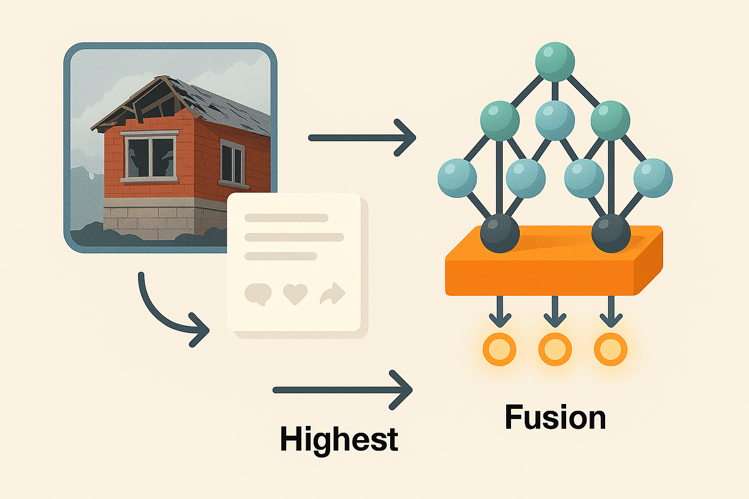
CrisisMMD Results
Interpretation:
Images capture strong structural cues
Text compensates for unclear images
Fusion gives highest performance
Supports hypothesis: multi-modal > unimodal

Slide 11
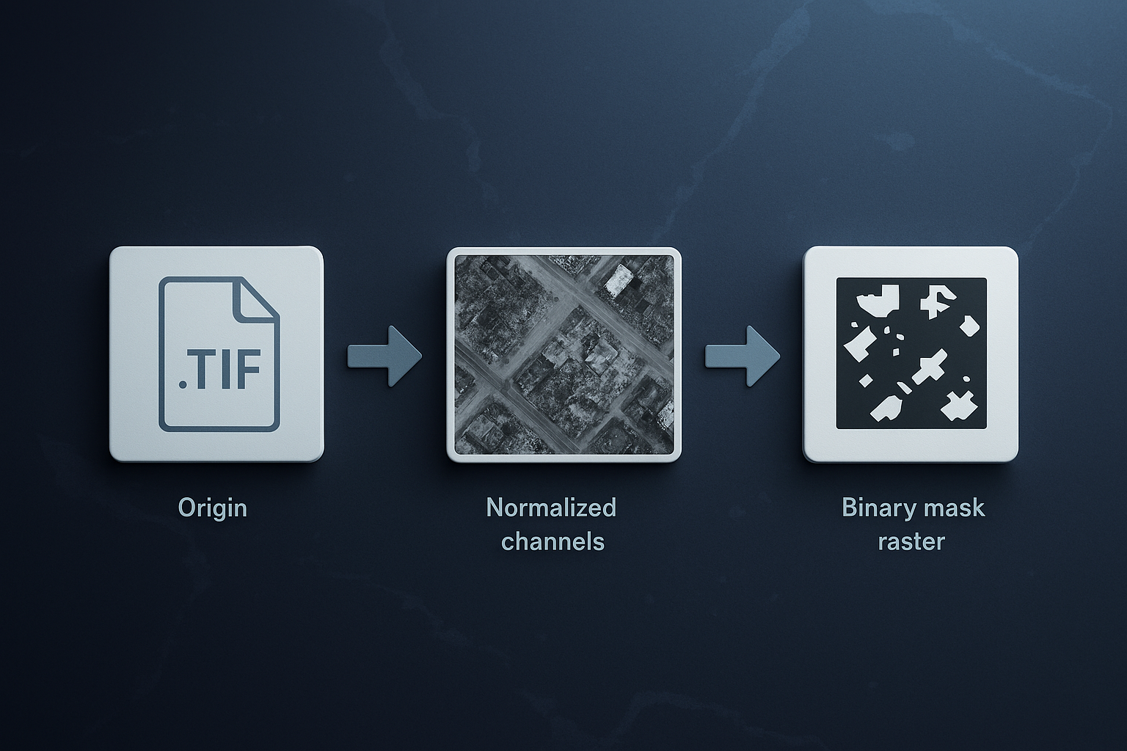
Bright Dataset Preprocessing
Satellite Imagery Workflow
Convert .tif rasters → 256×256 tiles
Normalize channels (per-band percentile stretch)
Align post-event images with it’s mask
Create reproducible train/dev/test manifests
Challenges
Very large dataset (~22GB)
Lighting & shadow variability across events
No pre-event imagery
Mask imbalance (majority non-damage pixels)

Slide 12
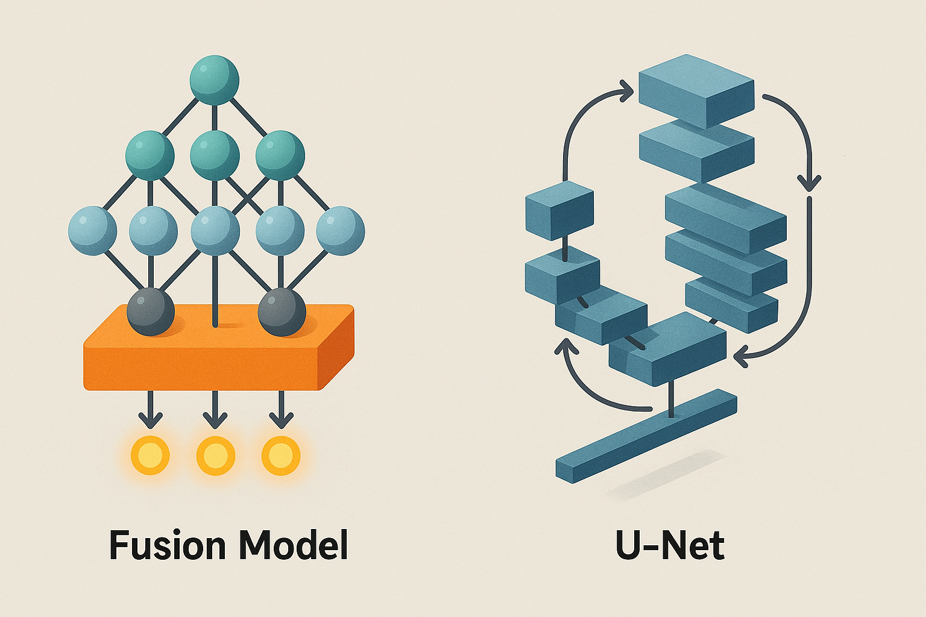
BRIGHT - U-Net Model & Training Setup
Model Architecture
Lightweight U-Net (custom)
Encoder-decoder with skip connections
Input: post-event 256x256 tiles
Output: binary mask (damaged vs non-damaged)
Training Details
Loss: BCE + Dice (balances extreme class imbalance)
Optimizer: AdamW (lr = 3e-4)
Mixed precision: torch.amp
Early stopping with patience = 3
Why This Setup
BRIGHT labels are heavily background-dominant
Small U-Net trains faster on local GPU
AMP reduces training time by ~30-40%
BCE+Dice improves sensitivity to damaged pixels

Slide 13
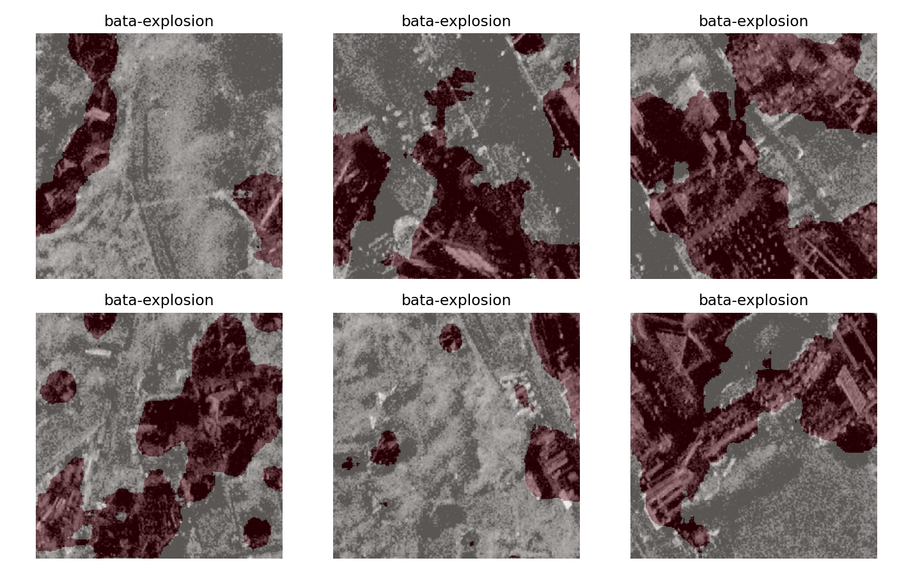
BRIGHT — Results (Quantitative Evaluation)
Validation Performance (Best Checkpoint)
IoU: 0.337
F1-score: 0.495
(from validation loader, early-stopped at best IoU)
Test Performance (10-scene fast evaluation)
IoU: 0.284
F1-score: 0.437
Results aggregated per scene (tile-level → scene-level)
Interpretation
Performance varies by event and scene complexity
Stronger on scenes with clear, clustered destruction
Weaker on sparse or low-damage regions (expected for post-only model)
Examples from the best-performing event: bata-explosion.

Slide 14
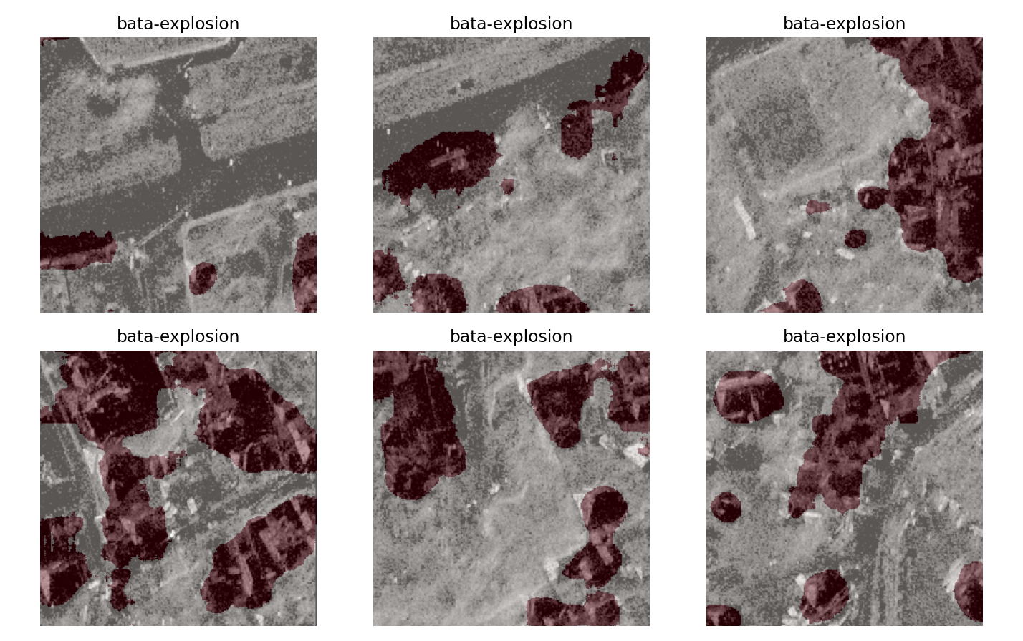
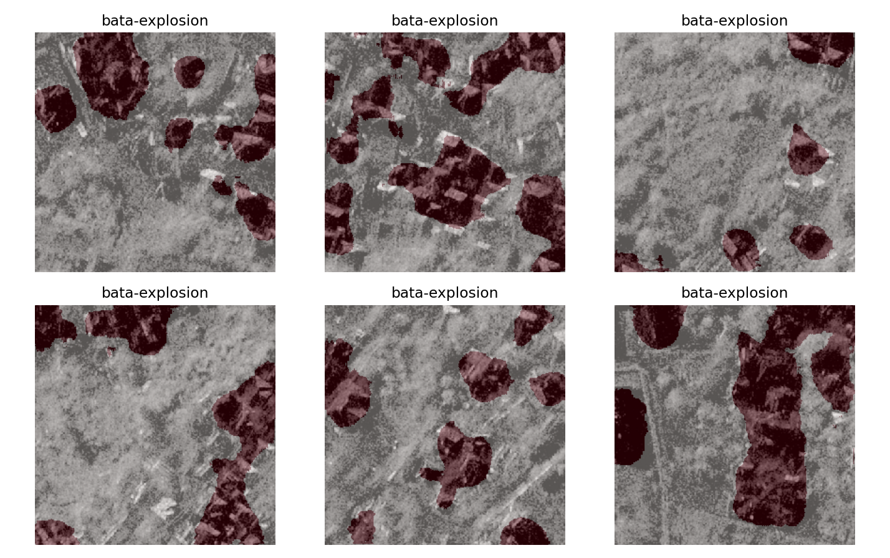
BRIGHT — Qualitative Damage Predictions (Overlays)
Model Behavior
U-Net predicts damaged regions directly from post-event tiles.
Red highlight = buildings classified as damaged.
Strong performance on dense, visually clear destruction.
What We Observe
Predictions follow building footprints accurately on many tiles.
Sparse-damage scenes remain challenging (as expected without pre-event imagery).
Why It Matters
Provides interpretable, spatially-resolved damage maps.
Useful for rapid triage and hotspot identification.

Slide 15
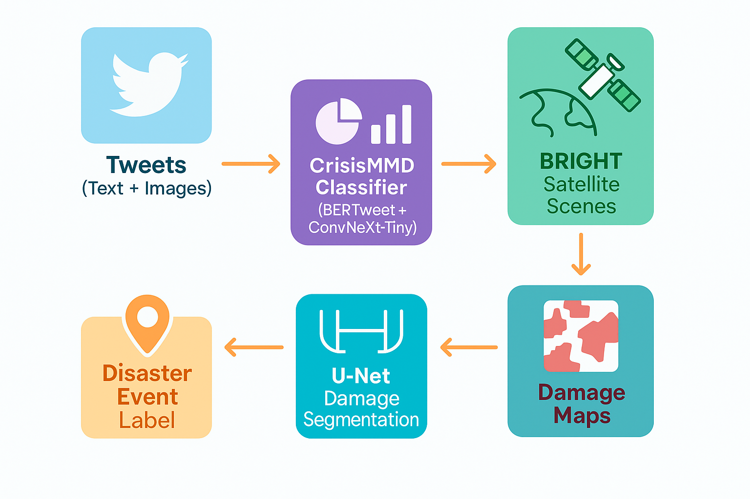
End-to-End Concept: From Social Signals → Satellite Damage Maps
Why Combine CrisisMMD + BRIGHT?
Social media gives immediate eyewitness signals (fast but noisy).
Satellite imagery gives reliable spatial damage maps (slow but precise).
Using social spikes (topics/events) helps prioritize satellite scenes.
Pipeline Concept
Stage-1 (CrisisMMD): Classify tweets into disaster categories.
Helps identify which events/areas have high activity.
Stage-2 (BRIGHT): Segment damage on satellite tiles for those events.
Produces actionable maps for responders.
What We Demonstrate in This Project
Stage-1 produces event labels (e.g., “explosion”).
Stage-2 evaluates satellite scenes belonging to that same event (e.g., bata-explosion).
Shows that a hierarchical multi-modal framework is feasible.

Slide 16
Limitations & Statistical Observations
Model Limitations
Post-event only satellite model → no “before vs after” contrast → harder to detect subtle damage
Label imbalance → most satellite pixels are non-damage; affects sensitivity
Domain shift across events → different disasters, lighting, sensors → inconsistent generalization
GPU + time constraints → U-Net training required long epochs; limited tuning possible
Statistical Findings
Fusion > single-modality → Macro-F1 improved from 0.55 (image-only) to 0.57 (fusion) → Shows modalities capture different, complementary signals
Scene-level scores vary widely (IoU: 0.12 → 0.34) → High variance implies dataset heterogeneity
Moderate F1 (0.43–0.51) → Indicates model identifies major damage clusters but misses finer shapes
Lessons Learned
Data quality (especially masks) drives performance
Tiling was essential for tractable training
Simple architectures + clean preprocessing beat “complex but messy” approaches
Fusion works best when modalities disagree (e.g., ambiguous text + clear image)

Slide 17
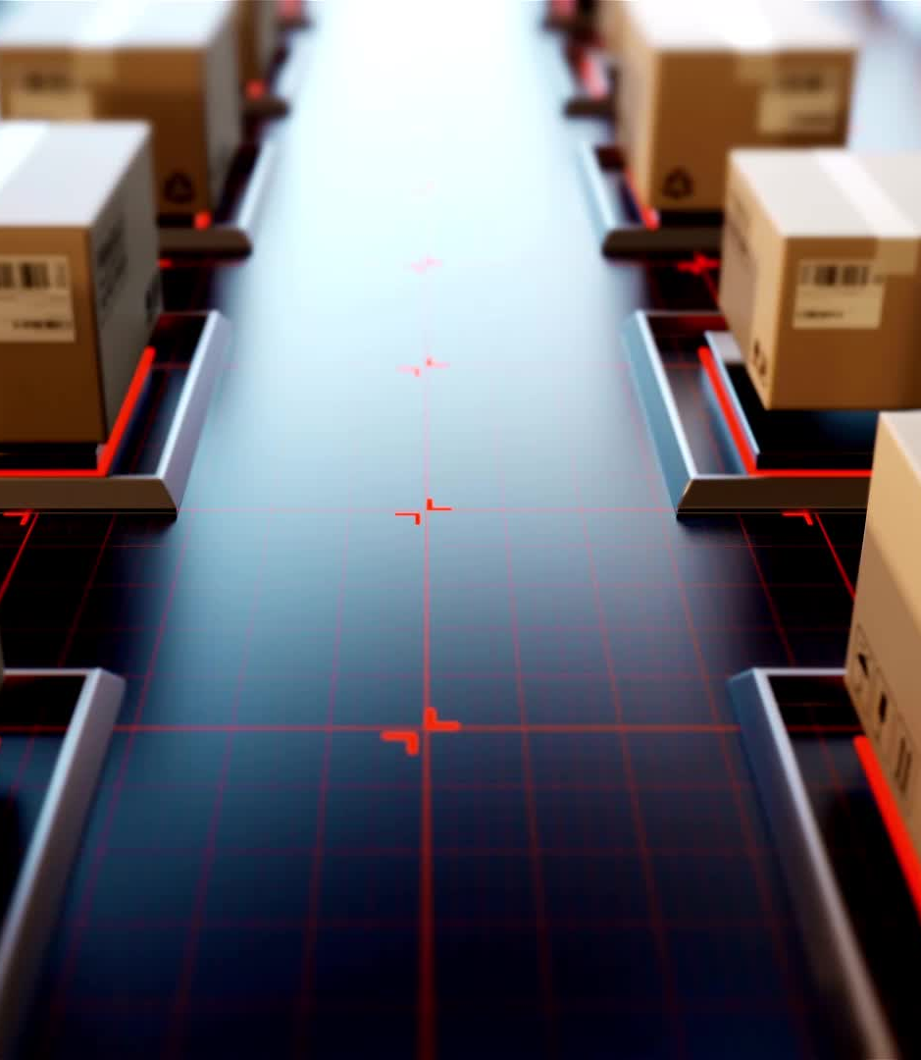
Future Work
Model Improvements
Incorporate pre-event images when available → train U-Net on 6-channel input
Replace U-Net encoder with ConvNeXt-Tiny for stronger feature extraction
Event-aware fine-tuning to reduce domain shift across disaster types
System Extensions
Link CrisisMMD outputs to BRIGHT scene selection for a full pipeline
Generate pixel-wise confidence maps to highlight uncertain regions
Build a lightweight Gradio viewer for overlays and tile exploration
Research Directions
Compare per-event vs global training statistically
Run paired tests for: text-only vs image-only vs fusion

Slide 18
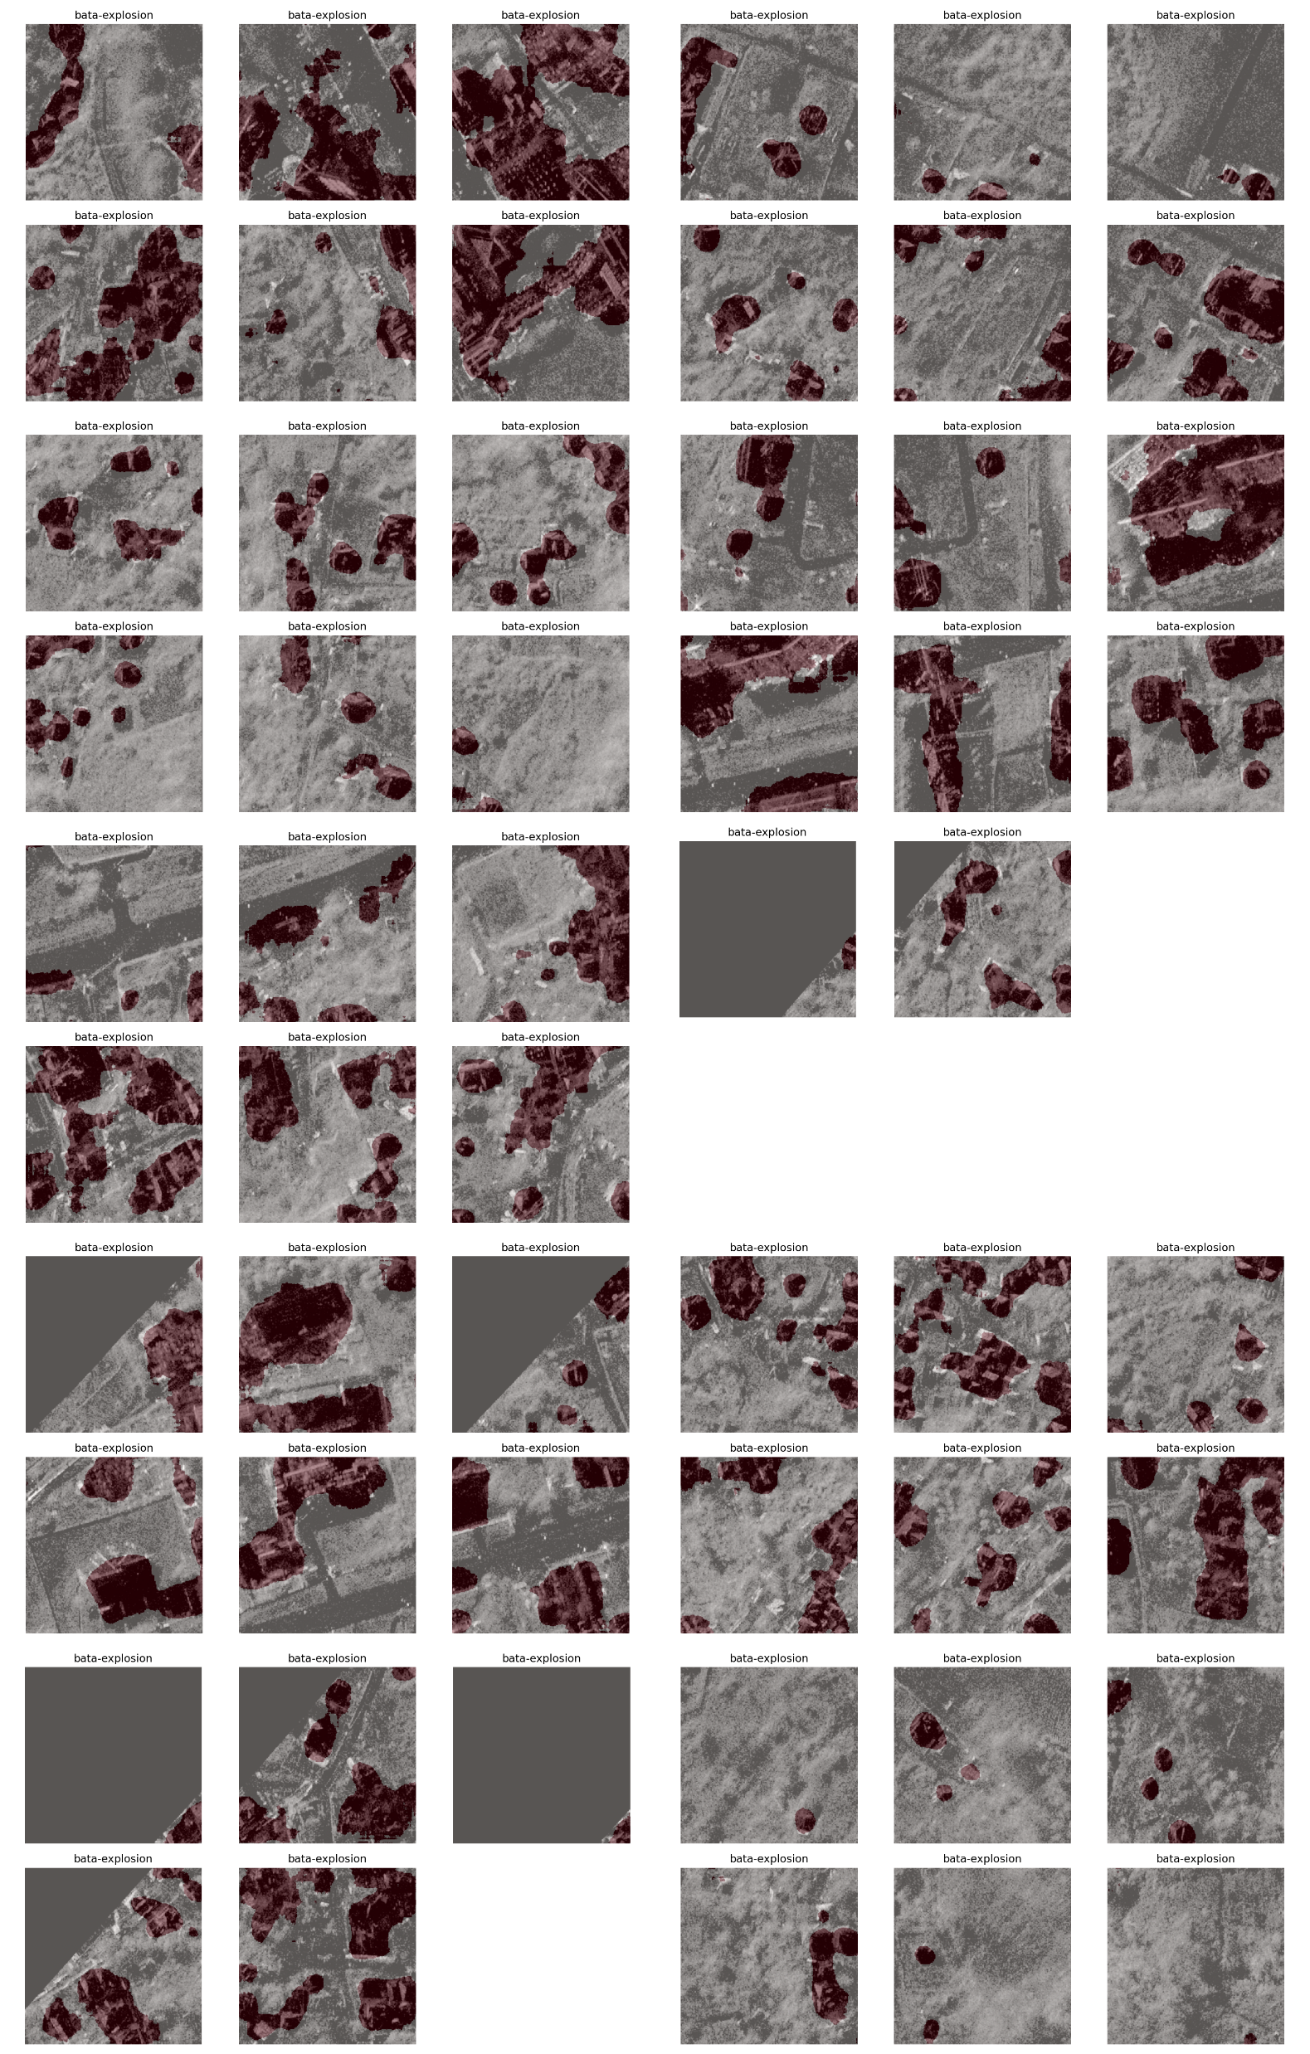
Conclusion & Thank You
Main takeaway
A simple two-stage pipeline (tweets → satellite tiles) can speed up and improve disaster damage assessment.
What we delivered
Multi-modal CrisisMMD classifier (text + image fusion)
U-Net–based BRIGHT damage segmentation
Quantitative improvements + clear visual overlays
Real-world impact
Faster hotspot identification
Scalable, pixel-level damage mapping

